Slide 1

School of Computer Application
Presented By -
Guided By - Mr. Sudhansu Sekhar Patra and
Mr. Rabindra Barik
Aayush Kumar Panda - 2075002
Aditya Dey - 2075003 Rohan Behera - 2075025

Slide 2
Video Games
Sales
Using data to solve problems creatively.

Slide 3
Introduction to data science
Data science involves collecting, analyzing, and interpreting large and complex data sets to derive insights and solve problems. It is a multidisciplinary field that combines statistics, computer science, and domain expertise. Data scientists use various tools and techniques such as machine learning, data visualization, and predictive modeling to extract valuable information from data. The insights gained from data science can be used to make informed business decisions, optimize processes, and drive innovation.

Slide 4
Application of data science
Data science is a multidisciplinary field that uses statistical and computational methods to extract knowledge and insights from data. The applications of data science are numerous and varied, and are used across a wide range of industries and fields. Some examples of the applications of data science are:
1. Predictive analytics: Predictive analytics uses data, statistical algorithms, and machine learning techniques to identify the likelihood of future outcomes based on historical data. This is widely used in finance, healthcare, marketing, and other industries.

Slide 5



Fraud detection: Data science is used to detect fraudulent activities in financial transactions, insurance claims, and other areas.
Image and speech recognition: Data science is used to build algorithms that can recognize images and speech. This is used in applications such as self-driving cars, facial recognition, and voice assistants.
Recommender systems: Recommender systems use data to provide recommendations to users based on their preferences and behavior. This is used in e-commerce, entertainment, and social media platforms.
Sports analytics: Data science is used to analyze data in sports to identify patterns and trends, and to make strategic decisions.

Slide 6
Challenges in data science
Data science is a rapidly growing field with many opportunities and challenges. Some of the main challenges in data science include:
Data quality: The quality of data used in data science projects is critical for accurate analysis and insights. Poor data quality can lead to incorrect conclusions, biased results, and unreliable predictions.
Data privacy and security: Data science projects often involve sensitive data, and ensuring the privacy and security of this data is a major challenge. Data breaches can have severe consequences, including financial loss and damage to reputation.

Slide 7

Lack of domain knowledge: Data scientists often work with data from a variety of domains, and understanding the context and underlying concepts of the data is critical for accurate analysis and interpretation. Scalability: Many data science projects involve large volumes of data, and ensuring that algorithms and models can scale to handle this data is a major challenge.
Continuous learning: Data science is a rapidly evolving field, and keeping up with new techniques and tools requires ongoing learning and development.

Slide 8
Future of data science
The future of data science is likely to be characterized by continued growth and innovation, as the amount of data generated and available for analysis continues to increase. Some potential future developments in data science include:
1. AI-driven automation: As AI and machine learning technologies continue to develop, more data science tasks are likely to be automated, leading to increased efficiency and scalability.

Slide 9
Continued development of data visualization tools: Data visualization tools will continue to evolve, making it easier for data scientists to communicate their findings and insights to a wider audience.
Increased use of edge computing and IoT devices: As the number of IoT devices continues to grow, data scientists will need to develop new techniques for analyzing and processing data at the edge, closer to where the data is generated.
Increased emphasis on data ethics and privacy: As concerns about data privacy and ethics continue to grow, data scientists will need to develop more robust methods for ensuring data privacy and ethical data use.

Slide 10

e
p
r
a
p
r
d
a
t
n
i
a
o
n
n
o
i
t
Identify data sources Data collection
Data cleaning
Data transformation Data analysis and visualization
c
e
l
l
o
c
a
t
a
D

Slide 11
Libraries
Libraries in data science are pre-built collections of tools, functions, and algorithms that help data scientists perform complex tasks quickly and efficiently. These libraries provide ready-made solutions for common data science problems, saving time and effort.
Popular data science libraries include NumPy, Pandas, Scikit-learn, and TensorFlow, which provide a range of functionalities for data. manipulation, machine learning, deep learning, visualization, and more. Libraries in data science are typically open-source, which means they are freely available for use and can be modified and improved by the community.

Slide 12
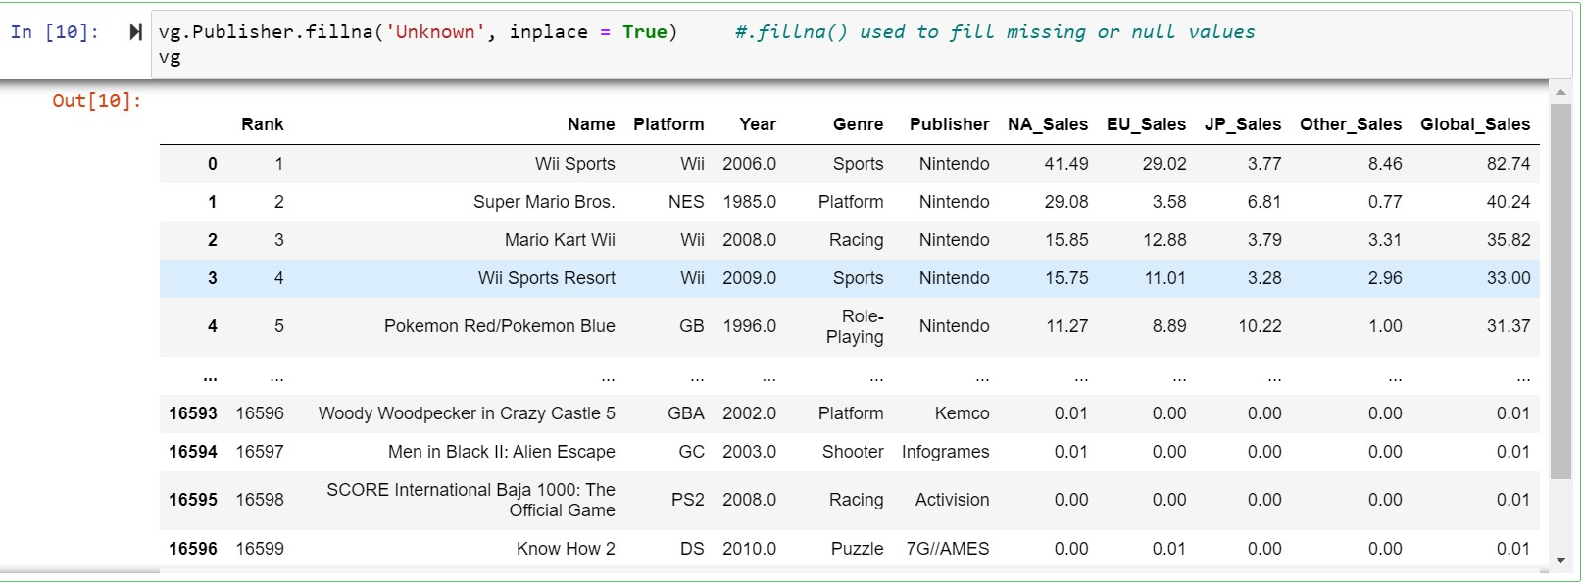
Data Preparation
Fill missing values in Publisher column
vg.Publisher.fillna('Unknown', inplace = True) #.fillna() used to fill missing or null values

Slide 13
Data analysis and visualization involve
examining, transforming, and modeling data to draw insights and make informed decisions. This process often involves using software tools to organize and manipulate large datasets, as well as creating visualizations such as charts, graphs, and maps to better understand the patterns and relationships within the data. Effective data analysis and visualization can be crucial for identifying trends, predicting future outcomes, and communicating findings to stakeholders.
DATA ANALYSIS
AND VISUALIZATION

Slide 14

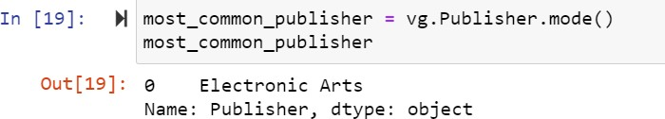
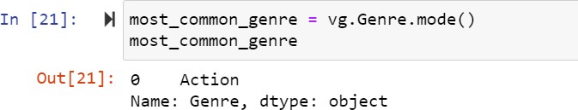
ANALYSIS
Most common video game publisher:
Most common genre:

Slide 15
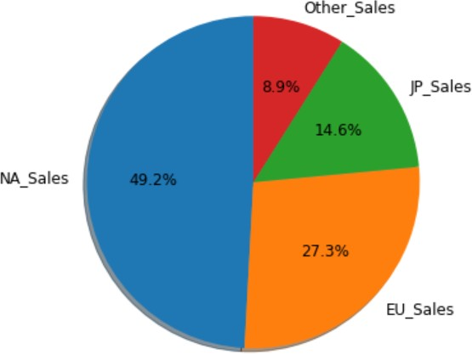
VISUALIZATION
labels = top_sale_reg['region'] sizes = top_sale_reg['sale']
plt.figure(figsize=(8, 6))#autopct: This is a string that specifies how to format the values of each slice as % plt.pie(sizes, labels=labels, autopct='%1.1f%%', shadow = True, startangle = 90 )
plt.show()#startangle: This is a float value that specifies the angle at which the first slice of the pie chart

Slide 16
Prediction
Prediction in data science refers to the process of using statistical or machine learning algorithms to make educated guesses about future outcomes based on past data.
This involves identifying patterns in historical data and using those patterns to forecast what might happen in the future.
The accuracy of predictions can be improved through the use of more sophisticated algorithms, larger and more diverse datasets, and careful feature engineering.

Slide 17
Decision Tree
A decision tree is a type of supervised machine learning used to categorize or make predictions based on how a previous set of questions were answered. The model is a form of supervised learning, meaning that the model is trained and tested on a set of data that contains the desired categorization.
Decision trees are widely used in various fields, including finance, healthcare, and marketing, for tasks such as risk analysis, medical diagnosis, and customer segmentation.

Slide 18
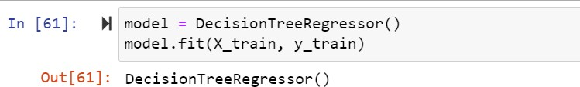
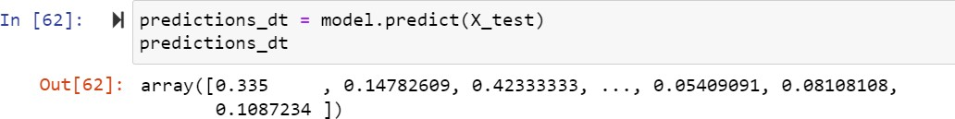
#Fit the model
#Make predictions

Slide 19
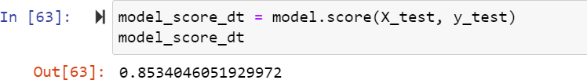
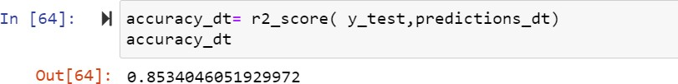
#Calculate the score of the model
#Calculate the accuracy of the model

Slide 20
Linear Regression
Linear regression is a data analysis technique that predicts the value of unknown data by using another related and known data value. It mathematically models the unknown or dependent variable and the known or independent variable as a linear equation.
The equation for multiple linear regression, which includes more than one independent variable, is:
y = a + b₁x₁ + b₂x₂ + ... + bₖxₖ where:
y is the dependent variable
x₁, x₂, ..., xₖ are the k independent variables a is the intercept
b₁, b₂, ..., bₖ are the coefficients (slopes) of the independent variables

Slide 21
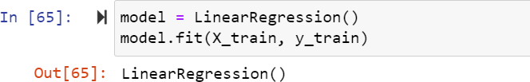
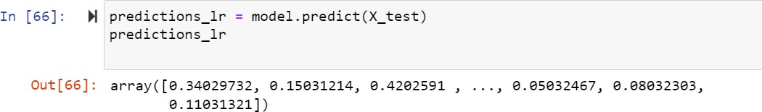
#Fit the model
#Make predictions

Slide 22
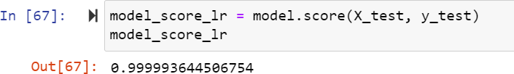
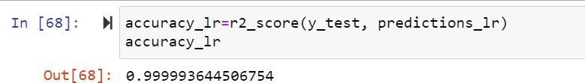
#Calculate the score of the model
#Calculate the accuracy of the model

Slide 23
Conclusion
In this data science project, we analyzed the data of video game sales to make predictions about the future sales of video games. We started by exploring the data, cleaning and pre-processing it, and visualizing the relationships between different variables using various statistical and visualization techniques. We used machine learning algorithms such as linear regression to model the relationships between different variables and make predictions about the future sales of video games.

Slide 24

o
y
o
u
f
r
y
o
u
k
r
t
a
n
i
h
m
T
e
!

